Slide 1
IBM DATA ANALYST CAPSTONE PROJECT:
Review of Technological Advancements and Skill Demands
SHIFAN ABRAR RASHID

Slide 2
The Outline
Executive Summary
Introduction
Methodology
Trends
Findings
Conclusion

Slide 3
Executive Summary
This report highlights current trends and future trends for skills in technologies using comprehensive analysis. Additionally, it analyzes the demographics of professionals in these sectors
Data collected, cleaned, visualized from Stack Overflow, IBM, GitHub
Results: JavaScript is the most popular language. MySQL has the highest usage in case of Databases
Postgre SQL is projected to have more demand in the future

Slide 4

Introduction
Which languages are in the most demand today? What are the popular database skills? What are the popular IDEs or Web Frames?
These are the question this analysis aimed to investigate. The core audience are Developers, IT professional who want to learn the most relevant IT skills

Slide 5
Methodology
Gathering Data: Number of jobs were gathered from GitHub jobs API on Python
IBM: Names of Programming Languages and Annual Wages were scraped from IBM website and dataset of 2019 Stack Overflow was saved
Cleaning & EDA: Data was analyzed and cleaned by Python. Exploratory Data Analysis was carried out
Visualization: Charts, Graphs & Dashboards were created using Python and IBM Cognos Analytics

Slide 6
THE TRENDS

Slide 7
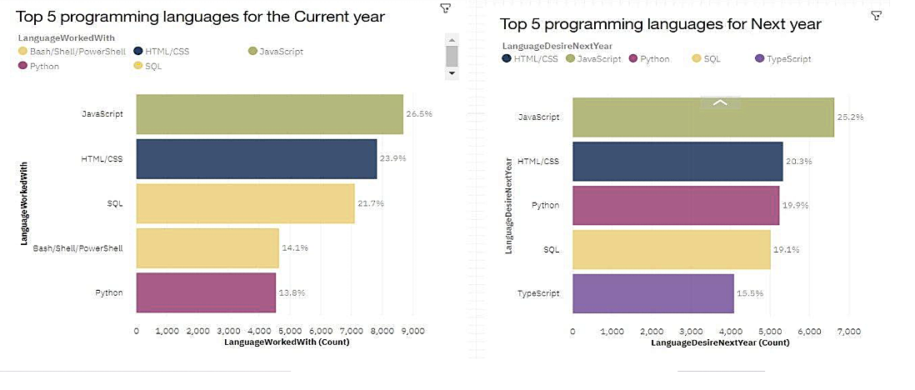
PROGRAMMING LANGUAGES
CURRENT
NEXT

Slide 8
PROGRAMMING LANGUAGES
JavaScript, HTML/CSS, SQL, Shell, Python are the most used languages currently
They will also be the most used languages next year
Since JavaScript and HTML are used for web development, it means that web development is the tech skill with the highest demand
Python is gaining increased popularity due to AI and ML skills
For data professionals, SQL is the most relevant language. But Python will have more demand than SQL next year

Slide 9
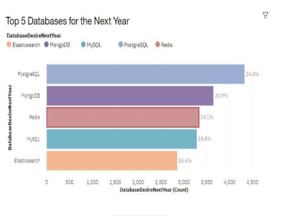
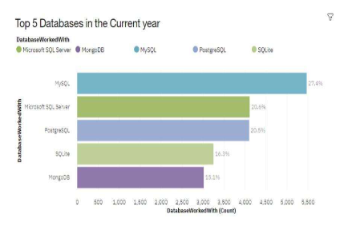
DATABASES
CURRENT
NEXT

Slide 10
DATABASES
MySQL, Postgre SQL, SQLite, MongoDB, MicrosoftSQLserver are the top 5 most use Databases
Only Postgre SQL, MongoDB, Redis, MySQL are projected to increase in popularity
Redis and Elasticsense are relatively new tools
SQL is one of the most important skill for data specialist
Companies prefer Open Sourcwe Databases
Oracle SQL was not among the top 5 and is losing relevance

Slide 11
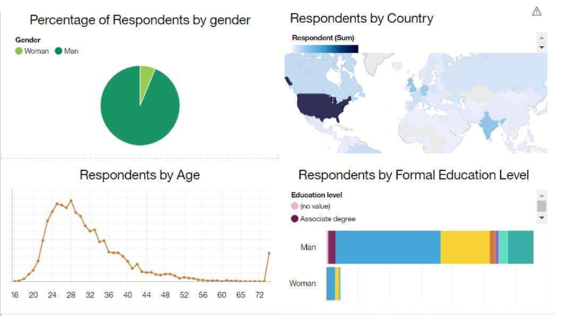
DASHBOARD

Slide 12
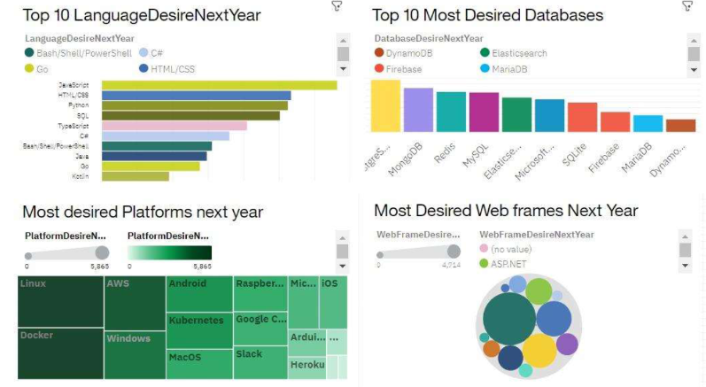
DASHBOARD

Slide 13
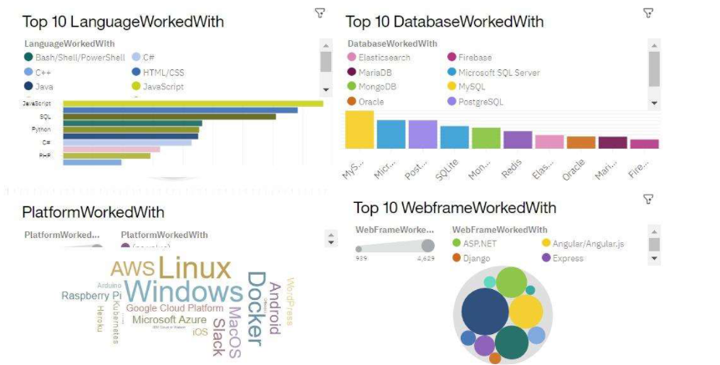
DASHBOARD

Slide 14
THE FINDINGS
Most people in IT have a Bachelor’s degree
Web Development languages are the most popular and on-demand tools
Majority of the Tech sector is filled with people under 40 years old
Most of the people want to learn Postgre SQL and React.js in the coming year
It is important for data professionals to develop skills in NoSQL
Less developed countries need more access to tech education

Slide 15
Conclusion
It is of high importance to stay updated in
The Tech Sector as the Trends keep changing over time

